Slide 1
Lecture - 11 on
Data Structures(Graph)

Slide 2
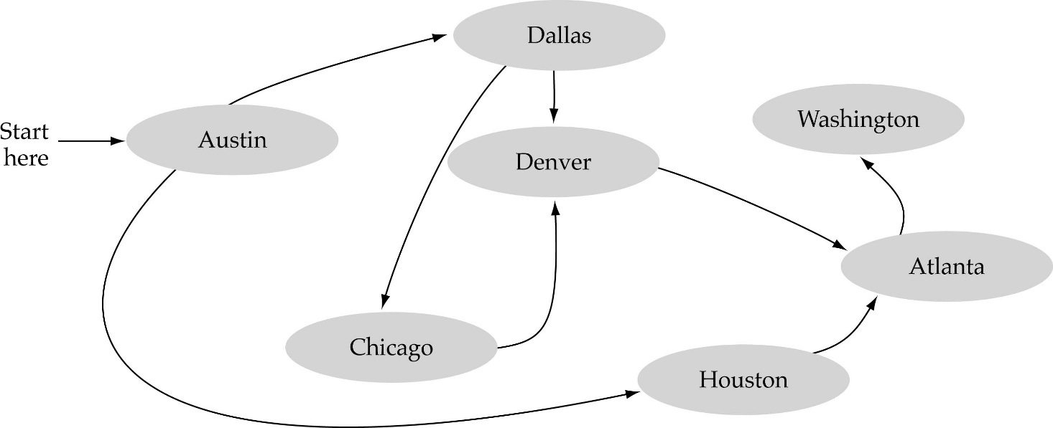
What is a graph?
A data structure that consists of a set of nodes (vertices) and a set of edges that relate the nodes to each other
The set of edges describes relationships among the vertices

Slide 3
Formal definition of graphs
A graph G is defined as follows:
G=(V,E)
V(G): a finite, nonempty set of vertices
E(G): a set of edges (pairs of vertices)

Slide 4
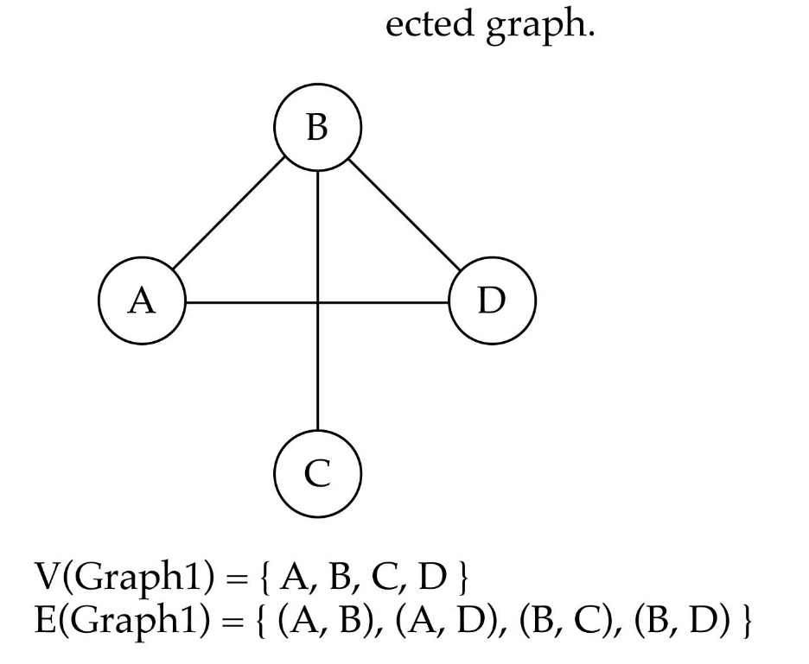
Directed vs. undirected graphs
When the edges in a graph have no direction, the graph is called undirected

Slide 5

Directed vs. undirected graphs (cont.)
When the edges in a graph have a direction, the graph is called directed (or digraph)
Warning: if the graph is directed, the order of the vertices in each edge is important !!
E(Graph2) = {(1,3) (3,1) (5,9) (9,11) (5,7)

Slide 6

Trees vs graphs
Trees are special cases of graphs!!

Slide 7

Graph terminology
Adjacent nodes: two nodes are adjacent if they are connected by an edge
Path: a sequence of vertices that connect two nodes in a graph
Complete graph: a graph in which every vertex is directly connected to every other vertex
5 is adjacent to 7
7 is adjacent from 5

Slide 8
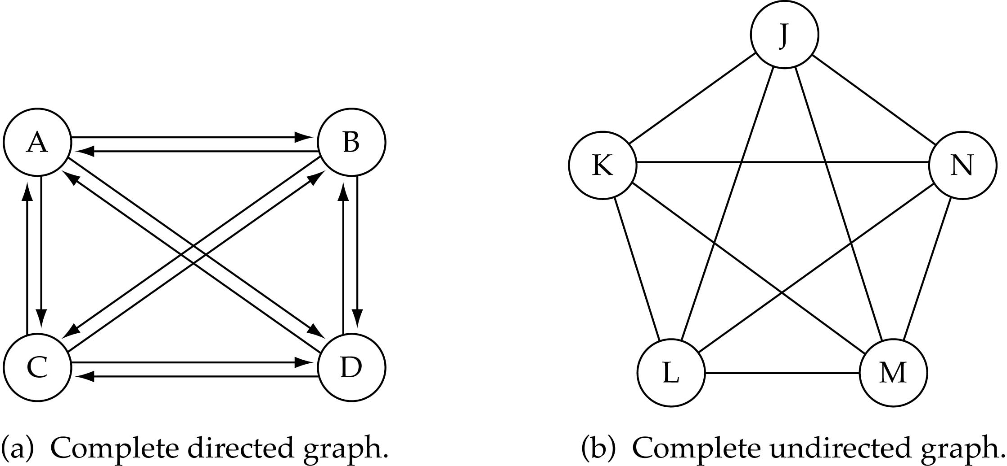
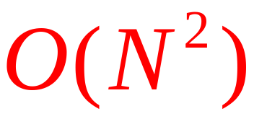
Graph terminology (cont.)
What is the number of edges in a complete directed graph with N vertices?
N * (N-1)

Slide 9
Graph terminology (cont.)
What is the number of edges in a complete undirected graph with N vertices?
N * (N-1) / 2

Slide 10
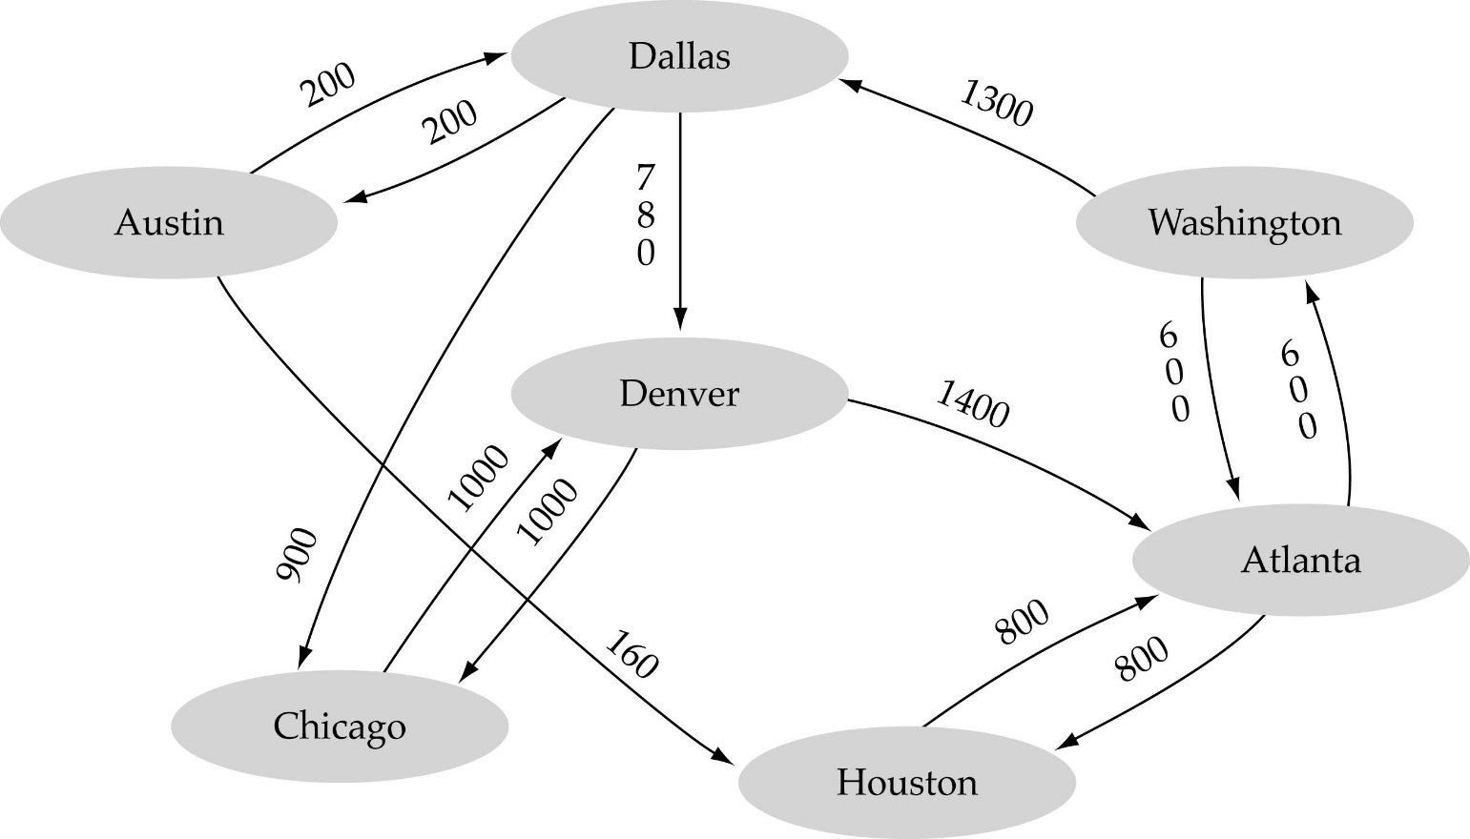
Graph terminology (cont.)
Weighted graph: a graph in which each edge carries a value

Slide 11

Graph implementation
Array-based implementation
  A 1D array is used to represent the vertices
  A 2D array (adjacency matrix) is used to represent the edges

Slide 12
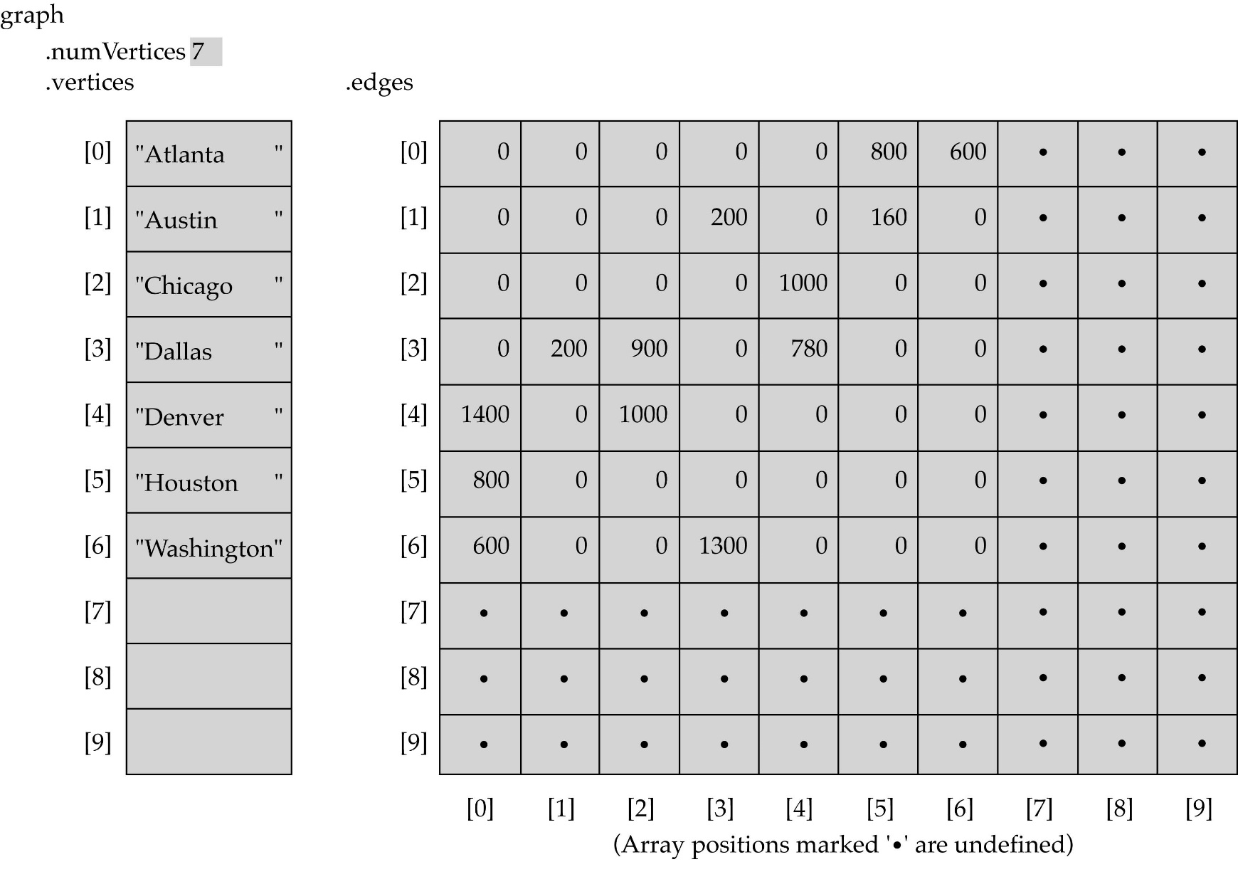
Array-based implementation

Slide 13

Graph implementation (cont.)
Linked-list implementation
  A 1D array is used to represent the vertices
  A list is used for each vertex v which contains the vertices which are adjacent from v (adjacency list)

Slide 14
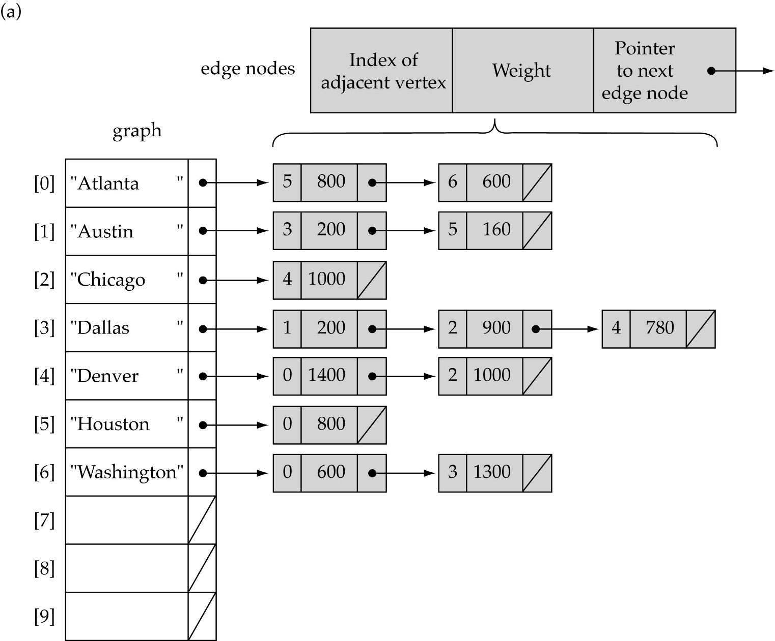
Linked-list implementation

Slide 15
Adjacency matrix vs. adjacency list representation
Adjacency matrix
  Good for dense graphs --|E|~O(|V|²)
  Memory requirements: O(|V| + |E| ) = O(|V|² )
  Connectivity between two vertices can be tested quickly
Adjacency list
  Good for sparse graphs -- |E|~O(|V|)
  Memory requirements: O(|V| + |E|)=O(|V|)
  Vertices adjacent to another vertex can be found quickly

Slide 16
Graph specification based on adjacency matrix representation
const int NULL_EDGE = 0;
template<class VertexType>
class GraphType {
public:
GraphType(int);
~GraphType();
void MakeEmpty();
bool IsEmpty() const;
bool IsFull() const;
void AddVertex(VertexType);
void AddEdge(VertexType, VertexType, int);
int WeightIs(VertexType, VertexType);
void GetToVertices(VertexType, QueType<VertexType>&);
void ClearMarks();
void MarkVertex(VertexType);
bool IsMarked(VertexType) const;
private:
int numVertices;
int maxVertices;
VertexType* vertices;
int **edges;
bool* marks;
};
(continues)

Slide 17
template<class VertexType>
GraphType<VertexType>::GraphType(int maxV)
{
numVertices = 0;
maxVertices = maxV;
vertices = new VertexType[maxV];
edges = new int[maxV];
for(int i = 0; i < maxV; i++)
edges[i] = new int[maxV];
marks = new bool[maxV];
}
template<class VertexType>
GraphType<VertexType>::~GraphType()
{
delete [] vertices;
for(int i = 0; i < maxVertices; i++)
delete [] edges[i];
delete [] edges;
delete [] marks;
}
(continues)

Slide 18
Graph Traversal
Application example
  Given a graph representation and a vertex s in the graph
  Find paths from s to other vertices
Two common graph traversal algorithms
    Breadth-First Search (BFS)
      Find the shortest paths in an unweighted graph
    Depth-First Search (DFS)
      Topological sort
      Find strongly connected components

Slide 19
BFS and Shortest Path Problem
Given any source vertex s, BFS visits the other vertices at increasing distances away from s. In doing so, BFS discovers paths from s to other vertices
What do we mean by “distance”? The number of edges on a path from s
Example
0
Consider s=vertex 1
8
2
Nodes at distance 1?
2, 3, 7, 9
1
2
s
9
1
1
Nodes at distance 2?
8, 6, 5, 4
7
1
3
6
2
4
1
5
Nodes at distance 3?
0
2
2

Slide 20
Graph Searching
Given: a graph G = (V, E), directed or undirected
Goal: methodically explore every vertex and every edge
Ultimately: build a tree on the graph
  Pick a vertex as the root
  Choose certain edges to produce a tree
  Note: might also build a forest if graph is not connected

Slide 21
Breadth-First Search
“Explore” a graph, turning it into a tree
  One vertex at a time
  Expand frontier of explored vertices across the breadth of the frontier
Builds a tree over the graph
  Pick a source vertex to be the root
  Find (“discover”) its children, then their children, etc.

Slide 22
Breadth-First Search
Every vertex of a graph contains a color at every moment:
  White vertices have not been discovered
    All vertices start with white initially
  Grey vertices are discovered but not fully explored
    They may be adjacent to white vertices
  Black vertices are discovered and fully explored
    They are adjacent only to black and gray vertices
Explore vertices by scanning adjacency list of grey vertices

Slide 23
Breadth-First Search: The Code
Data: color[V], prev[V],d[V]
BFS(G) // starts from here
{
for each vertex u ∈ V-{s}
{
color[u]=WHITE;
prev[u]=NIL;
d[u]=inf;
}
color[s]=GRAY;
d[s]=0; prev[s]=NIL;
Q=empty;
ENQUEUE(Q,s);
While(Q not empty)
{
u = DEQUEUE(Q);
for each v ∈ adj[u]{
if (color[v] == WHITE){
color[v] = GREY;
d[v] = d[u] + 1;
prev[v] = u;
Enqueue(Q, v);
}
}
color[u] = BLACK;
}
}

Slide 24
Breadth-First Search: Example
r
s
t
u
∞
∞
∞
∞
∞
∞
∞
∞
v
w
x
y
Vertex | r | s | t | u | v | w | x | y
color | W | W | W | W | W | W | W | W
d | ∞ | ∞ | ∞ | ∞ | ∞ | ∞ | ∞ | ∞
prev | nil | nil | nil | nil | nil | nil | nil | nil

Slide 25
Breadth-First Search: Example
r
s
t
u
∞
0
∞
∞
∞
∞
∞
∞
v
w
x
y
Q:
s
vertex | r | s | t | u | v | w | x | y
Color | W | G | W | W | W | W | W | W
d | ∞ | 0 | ∞ | ∞ | ∞ | ∞ | ∞ | ∞
prev | nil | nil | nil | nil | nil | nil | nil | nil

Slide 26
Breadth-First Search: Example
r
s
t
u
1
0
∞
∞
∞
1
∞
∞
v
w
x
y
Q:
s
w
r
vertex | r | s | t | u | v | w | x | y
Color | G | B | W | W | W | G | W | W
d | 1 | 0 | ∞ | ∞ | ∞ | 1 | ∞ | ∞
prev | s | nil | nil | nil | nil | s | nil | nil

Slide 27
Breadth-First Search: Example
r
s
t
u
1
0
2
∞
∞
1
2
∞
v
w
x
y
Q:
s
w
r
t
x
vertex | r | s | t | u | V | w | X | y
Color | G | B | G | W | W | B | G | W
d | 1 | 0 | 2 | ∞ | ∞ | 1 | 2 | ∞
prev | s | nil | w | nil | nil | s | w | nil

Slide 28
Breadth-First Search: Example
r
s
t
u
1
0
2
∞
2
1
2
∞
v
w
x
y
Q:
s
w
r
t
x
v
vertex | r | s | t | u | v | w | x | y
Color | B | B | G | W | G | B | G | W
d | 1 | 0 | 2 | ∞ | 2 | 1 | 2 | ∞
prev | s | nil | w | nil | r | s | w | nil

Slide 29
Breadth-First Search: Example
r
s
t
u
1
0
2
3
2
1
2
∞
v
w
x
y
Q:
s
w
r
t
x
v
u
vertex | r | s | t | u | v | w | x | y
Color | B | B | B | G | G | B | G | W
d | 1 | 0 | 2 | 3 | 2 | 1 | 2 | ∞
prev | s | nil | w | t | r | s | w | nil

Slide 30
Breadth-First Search: Example
r
s
t
u
1
0
2
3
2
1
2
3
v
w
x
y
Q:
s
w
r
t
x
v
u
y
vertex | r | s | t | u | v | w | x | y
Color | B | B | B | G | G | B | B | G
d | 1 | 0 | 2 | 3 | 2 | 1 | 2 | 3
prev | s | nil | w | t | r | s | w | x

Slide 31
Breadth-First Search: Example
r
s
t
u
1
0
2
3
2
1
2
3
v
w
x
y
Q:
s
w
r
t
x
v
u
y
vertex | r | s | t | u | v | w | x | y
Color | B | B | B | G | B | B | B | G
d | 1 | 0 | 2 | 3 | 2 | 1 | 2 | 3
prev | s | nil | w | t | r | s | w | x

Slide 32
Breadth-First Search: Example
r
s
t
u
1
0
2
3
2
1
2
3
v
w
x
y
Q:
s
w
r
t
x
v
u
y
vertex | r | s | t | u | v | w | x | y
Color | B | B | B | B | B | B | B | G
d | 1 | 0 | 2 | 3 | 2 | 1 | 2 | 3
prev | s | nil | w | t | r | s | w | x

Slide 33
Breadth-First Search: Example
r
s
t
u
1
0
2
3
2
1
2
3
v
w
x
y
Q:
s
w
r
t
x
v
u
y
vertex | r | s | t | u | v | w | x | y
Color | B | B | B | G | B | B | B | B
d | 1 | 0 | 2 | 3 | 2 | 1 | 2 | 3
prev | s | nil | w | t | r | s | w | x

Slide 34
BFS: The Code (again)
Data: color[V], prev[V],d[V]
BFS(G) // starts from here
{
for each vertex u ∈ V-{s}
{
color[u]=WHITE;
prev[u]=NIL;
d[u]=inf;
}
color[s]=GRAY;
d[s]=0; prev[s]=NIL;
Q=empty;
ENQUEUE(Q,s);
While(Q not empty)
{
u = DEQUEUE(Q);
for each v ∈ adj[u]{
if (color[v] == WHITE){
color[v] = GREY;
d[v] = d[u] + 1;
prev[v] = u;
Enqueue(Q, v);
}
}
color[u] = BLACK;
}
}

Slide 35
Breadth-First Search: Print Path
Data: color[V], prev[V],d[V]
Print-Path(G, s, v)
{
if(v==s)
print(s)
else if(prev[v]==NIL)
print(No path);
else{
Print-Path(G,s,prev[v]);
print(v);
}
}

Slide 36
Amortized Analysis
Stack with 3 operations:
  Push, Pop, Multi-pop
What will be the complexity if “n” operations are performed?

Slide 37
BFS: Complexity
Data: color[V], prev[V],d[V]
BFS(G) // starts from here
{
for each vertex u ∈ V-{s}
{
color[u]=WHITE;
prev[u]=NIL;
d[u]=inf;
}
color[s]=GRAY;
d[s]=0; prev[s]=NIL;
Q=empty;
ENQUEUE(Q,s);
While(Q not empty)
{
u = DEQUEUE(Q);
for each v ∈ adj[u]{
if(color[v] == WHITE){
color[v] = GREY;
d[v] = d[u] + 1;
prev[v] = u;
Enqueue(Q, v);
}
}
color[u] = BLACK;
}
}
u = every vertex, but only once
(Why?)
O(V)
O(V)
What will be the running time?
Total running time: O(V+E)

Slide 38
Breadth-First Search: Properties
BFS calculates the shortest-path distance to the source node
  Shortest-path distance δ(s,v) = minimum number of edges from s to v, or ∞ if v not reachable from s
  Proof given in the book (p. 472-5)
BFS builds breadth-first tree, in which paths to root represent shortest paths in G
  Thus can use BFS to calculate shortest path from one vertex to another in O(V+E) time

Slide 39
Application of BFS
Find the shortest path in an undirected/directed unweighted graph.
Find the bipartiteness of a graph.
Find cycle in a graph.
Find the connectedness of a graph.

Slide 40
Depth-First Search
Input:
  G = (V, E) (No source vertex given!)
Goal:
  Explore the edges of G to “discover” every vertex in V starting at the most current visited node
  Search may be repeated from multiple sources
Output:
  2 timestamps on each vertex:
    d[v] = discovery time
    f[v] = finishing time (done with examining v’s adjacency list)
  Depth-first forest
1
2
3
5
4

Slide 41
Depth-First Search
Search “deeper” in the graph whenever possible
Edges are explored out of the most recently discovered vertex v that still has unexplored edges
2
1
3
5
4
After all edges of v have been explored, the search “backtracks” from the parent of v
The process continues until all vertices reachable from the original source have been discovered
If undiscovered vertices remain, choose one of them as a new source and repeat the search from that vertex
DFS creates a “depth-first forest”

Slide 42
DFS Additional Data Structures
Global variable: time-stamp
  Incremented when nodes are discovered or finished
color[u] – similar to BFS
  White before discovery, gray while processing and black when finished processing
prev[u] – predecessor of u
d[u], f[u] – discovery and finish times
1 ≤ d[u] < f [u] ≤ 2 |V|
WHITE
GRAY
BLACK
0
d[u]
f[u]
2V

Slide 43
Depth-First Search: The Code
Data: color[V], time, prev[V],d[V], f[V]
DFS(G) // where prog starts
{
for each vertex u ∈ V
{
color[u] = WHITE;
prev[u]=NIL;
f[u]=inf; d[u]=inf;
}
time = 0;
for each vertex u ∈ V
if (color[u] == WHITE)
DFS_Visit(u);
}
DFS_Visit(u)
{
color[u] = GREY;
time = time+1;
d[u] = time;
for each v ∈ Adj[u]
{
if(color[v] == WHITE){
prev[v]=u;
DFS_Visit(v);}
}
color[u] = BLACK;
time = time+1;
f[u] = time;
}
Initialize

Slide 44
Depth-First Search: The Code
Data: color[V], time, prev[V],d[V], f[V]
DFS(G) // where prog starts
{
for each vertex u ∈ V
{
color[u] = WHITE;
prev[u]=NIL;
f[u]=inf; d[u]=inf;
}
time = 0;
for each vertex u ∈ V
if (color[u] == WHITE)
DFS_Visit(u);
}
DFS_Visit(u)
{
color[u] = GREY;
time = time+1;
d[u] = time;
for each v ∈ Adj[u]
{
if(color[v] == WHITE){
prev[v]=u;
DFS_Visit(v);}
}
color[u] = BLACK;
time = time+1;
f[u] = time;
}
What does d[u] represent?

Slide 45
Depth-First Search: The Code
Data: color[V], time, prev[V],d[V], f[V]
DFS(G) // where prog starts
{
for each vertex u ∈ V
{
color[u] = WHITE;
prev[u]=NIL;
f[u]=inf; d[u]=inf;
}
time = 0;
for each vertex u ∈ V
if (color[u] == WHITE)
DFS_Visit(u);
}
DFS_Visit(u)
{
color[u] = GREY;
time = time+1;
d[u] = time;
for each v ∈ Adj[u]
{
if(color[v] == WHITE){
prev[v]=u;
DFS_Visit(v);}
}
color[u] = BLACK;
time = time+1;
f[u] = time;
}
What does f[u] represent?

Slide 46
Depth-First Search: The Code
Data: color[V], time, prev[V],d[V], f[V]
DFS(G) // where prog starts
{
for each vertex u ∈ V
{
color[u] = WHITE;
prev[u]=NIL;
f[u]=inf; d[u]=inf;
}
time = 0;
for each vertex u ∈ V
if (color[u] == WHITE)
DFS_Visit(u);
}
DFS_Visit(u)
{
color[u] = GREY;
time = time+1;
d[u] = time;
for each v ∈ Adj[u]
{
if(color[v] == WHITE){
prev[v]=u;
DFS_Visit(v);
}}
color[u] = BLACK;
time = time+1;
f[u] = time;
}
Will all vertices eventually be colored black?

Slide 47
DFS Example
source
vertex
S
D
F
A
E
B
C
G

Slide 48
DFS Example
source
vertex
d f
F
S
D
1 |
|
|
A
|
|
E
|
|
|
B
C
G

Slide 49
DFS Example
source
vertex
d f
F
S
D
1 |
|
|
A
2 |
|
E
|
|
|
B
C
G

Slide 50
DFS Example
source
vertex
d f
F
S
D
1 |
|
|
A
2 |
|
E
3 |
|
|
B
C
G

Slide 51
DFS Example
source
vertex
d f
F
S
D
1 |
|
|
A
2 |
|
E
3 | 4
|
|
B
C
G

Slide 52
DFS Example
source
vertex
d f
F
S
D
1 |
|
|
A
2 |
|
E
3 | 4
5 |
|
B
C
G

Slide 53
DFS Example
source
vertex
d f
F
S
D
1 |
|
|
A
2 |
|
E
3 | 4
5 | 6
|
B
C
G

Slide 54
DFS Example
source
vertex
d f
F
S
D
1 |
|
|
A
2 | 7
|
E
3 | 4
5 | 6
|
B
C
G

Slide 55
DFS Example
source
vertex
d f
F
S
D
1 |
8 |
|
A
2 | 7
|
E
3 | 4
5 | 6
|
B
C
G

Slide 56
DFS Example
source
vertex
d f
F
S
D
1 |
8 |
|
A
2 | 7
9 |
E
3 | 4
5 | 6
|
B
C
G
What is the structure of the grey vertices?
What do they represent?

Slide 57
DFS Example
source
vertex
d f
F
S
D
1 |
8 |
|
A
2 | 7
9 |10
E
3 | 4
5 | 6
|
B
C
G

Slide 58
DFS Example
source
vertex
d f
F
S
D
1 |
8 |11
|
A
2 | 7
9 |10
E
3 | 4
5 | 6
|
B
C
G

Slide 59
DFS Example
source
vertex
d f
F
S
D
1 |12
8 |11
|
A
2 | 7
9 |10
E
3 | 4
5 | 6
|
B
C
G

Slide 60
DFS Example
source
vertex
d f
F
S
D
1 |12
8 |11
13|
A
2 | 7
9 |10
E
3 | 4
5 | 6
|
B
C
G

Slide 61
DFS Example
source
vertex
d f
F
S
D
1 |12
8 |11
13|
A
2 | 7
9 |10
E
3 | 4
5 | 6
14|
B
C
G

Slide 62
DFS Example
source
vertex
d f
F
S
D
1 |12
8 |11
13|
A
2 | 7
9 |10
E
3 | 4
5 | 6
14|15
B
C
G

Slide 63
DFS Example
source
vertex
d f
F
S
D
1 |12
8 |11
13|16
A
2 | 7
9 |10
E
3 | 4
5 | 6
14|15
B
C
G

Slide 64
Depth-First Search: The Code
Data: color[V], time, prev[V],d[V], f[V]
DFS(G) // where prog starts
{
for each vertex u ∈ V
{
color[u] = WHITE;
prev[u]=NIL;
f[u]=inf; d[u]=inf;
}
time = 0;
for each vertex u ∈ V
if (color[u] == WHITE)
DFS_Visit(u);
}
DFS_Visit(u)
{
color[u] = GREY;
time = time+1;
d[u] = time;
for each v ∈ Adj[u]
{
if (color[v] == WHITE)
prev[v]=u;
DFS_Visit(v);
}
color[u] = BLACK;
time = time+1;
f[u] = time;
}
What will be the running time?

Slide 65
Depth-First Search: The Code
Data: color[V], time, prev[V],d[V], f[V]
DFS(G) // where prog starts
{
for each vertex u ∈ V
{
color[u] = WHITE;
prev[u]=NIL;
f[u]=inf; d[u]=inf;
}
time = 0;
for each vertex u ∈ V
if (color[u] == WHITE)
DFS_Visit(u);
}
DFS_Visit(u)
{
color[u] = GREY;
time = time+1;
d[u] = time;
for each v ∈ Adj[u]
{
if (color[v] == WHITE)
prev[v]=u;
DFS_Visit(v);
}
color[u] = BLACK;
time = time+1;
f[u] = time;
}
O(V)
O(V)
O(V)
Running time: O(V²) because call DFS_Visit on each vertex,
and the loop over Adj[] can run as many as |V| times

Slide 66
Depth-First Search: The Code
Data: color[V], time, prev[V],d[V], f[V]
DFS(G) // where prog starts
{
for each vertex u ∈ V
{
color[u] = WHITE;
prev[u]=NIL;
f[u]=inf; d[u]=inf;
}
time = 0;
for each vertex u ∈ V
if (color[u] == WHITE)
DFS_Visit(u);
}
DFS_Visit(u)
{
color[u] = GREY;
time = time+1;
d[u] = time;
for each v ∈ Adj[u]
{
if (color[v] == WHITE)
prev[v]=u;
DFS_Visit(v);
}
color[u] = BLACK;
time = time+1;
f[u] = time;
}
BUT, there is actually a tighter bound.
How many times will DFS_Visit() actually be called?

Slide 67
Depth-First Search: The Code
Data: color[V], time, prev[V],d[V], f[V]
DFS(G) // where prog starts
{
for each vertex u ∈ V
{
color[u] = WHITE;
prev[u]=NIL;
f[u]=inf; d[u]=inf;
}
time = 0;
for each vertex u ∈ V
if (color[u] == WHITE)
DFS_Visit(u);
}
DFS_Visit(u)
{
color[u] = GREY;
time = time+1;
d[u] = time;
for each v ∈ Adj[u]
{
if (color[v] == WHITE)
prev[v]=u;
DFS_Visit(v);
}
color[u] = BLACK;
time = time+1;
f[u] = time;
}
So, running time of DFS = O(V+E)

Slide 68
Depth-First Sort Analysis
This running time argument is an informal example of amortized analysis
  “Charge” the exploration of edge to the edge:
    Each loop in DFS_Visit can be attributed to an edge in the graph
    Runs once per edge if directed graph, twice if undirected
    Thus loop will run in O(E) time, algorithm O(V+E)
      Considered linear for graph, b/c adj list requires O(V+E) storage
  Important to be comfortable with this kind of reasoning and analysis

Slide 69
DFS: Kinds of edges
DFS introduces an important distinction among edges in the original graph:
  Tree edge: encounter new (white) vertex
    The tree edges form a spanning forest
    Can tree edges form cycles? Why or why not?
      No

Slide 70
DFS Example
source
vertex
d f
1 |12
8 |11
13|16
2 | 7
9 |10
3 | 4
5 | 6
14|15
Tree edges

Slide 71
DFS: Kinds of edges
DFS introduces an important distinction among edges in the original graph:
  Tree edge: encounter new (white) vertex
  Back edge: from descendent to ancestor
    Encounter a grey vertex (grey to grey)
    Self loops are considered as to be back edge.

Slide 72
DFS Example
source
vertex
d f
1 |12
8 |11
13|16
2 | 7
9 |10
3 | 4
5 | 6
14|15
Tree edges
Back edges

Slide 73
DFS: Kinds of edges
DFS introduces an important distinction among edges in the original graph:
  Tree edge: encounter new (white) vertex
  Back edge: from descendent to ancestor
  Forward edge: from ancestor to descendent
    Not a tree edge, though
    From grey node to black node

Slide 74
DFS Example
source
vertex
d f
1 |12
8 |11
13|16
2 | 7
9 |10
3 | 4
5 | 6
14|15
Tree edges
Back edges
Forward edges

Slide 75
DFS: Kinds of edges
DFS introduces an important distinction among edges in the original graph:
  Tree edge: encounter new (white) vertex
  Back edge: from descendent to ancestor
  Forward edge: from ancestor to descendent
  Cross edge: between a tree or subtrees
    From a grey node to a black node

Slide 76
DFS Example
source
vertex
d f
1 |12
8 |11
13|16
2 | 7
9 |10
3 | 4
5 | 6
14|15
Tree edges
Back edges
Forward edges
Cross edges

